Slide 1
What Is Redux?
Redux is a framework that controls states in a JavaScript app.
According to the official site: Redux is a predictable state container for JavaScript apps. It stands out from the landscape of libraries and frameworks by getting so many things absolutely right: A simple, predictable state model. An emphasis on functional programming and immutable data
.

Slide 2
When should I use Redux?
In general, use Redux when you have reasonable amounts of data changing over time, you need a single source of truth, and you find that approaches like keeping everything in a top-level React component's state are no longer sufficient.

Slide 3
Three Principles
Redux can be described in three fundamental principles:
The state of our whole application is stored in an object tree within a single store.
The only way to change the state is to emit an action, an object describing what happened.
To specify how the state tree is transformed by actions, you write pure reducers.

Slide 4
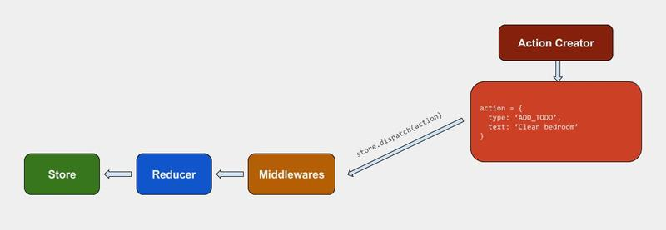
How does Redux Work?

Slide 5
Redux can be broken down into the following:
Action Creators
They are the function that creates Actions.In Redux this function simply returns an action.
function addTodo(text)
{
return
{
type: ADD_TODO,
text
}
}

Slide 6
Action
Actions are payloads of information that send data from your application to your store. It is a simple, plain JavaScript object. An action can also be considered as a command to change a state.
{
type: ADD_TODO,
text: 'Build my first Redux app'
}

Slide 7
Middleware
It provides a third-party extension point between dispatching an action, and the moment it reaches the reducer. People use Redux middleware for logging, crash reporting, talking to an asynchronous API, routing, and more.
Some of the examples of Middleware are:
Redux-Thunk
Redux-Promise
Redux-Logger

Slide 8
Middleware is the middleman between a store.dispatch() and a reducer. Its purpose is to intercept an action that has been dispatched, and modify or even cancel the action before it reaches the reducer.
import { createStore } from 'redux'
import todoApp from './reducers'
Import logger from redux-logger
let store = createStore(todoApp,logger)

Slide 9
Reducer
Reducer decides how to change a state after receiving an action, and thus can be considered the entrance of a state change. A reducer is comprised of functions, and it changes states by taking an action as an argument, in which it then returns a new state.

Slide 10
Store
The Store is the object that brings them together. The store has the following responsibilities:
Holds application state;
Allows access to state via getState();
Allows state to be updated via dispatch(action);
We used combineReducers() to combine several reducers into one. We will now import it, and pass it to createStore().

Slide 11
import { createStore } from 'redux'
import todoApp from './reducers'
let store = createStore(todoApp)

Slide 12
Thank You. Any questions ?

